Slide 1

Varroa Mite Treatments What are your options?
April Kustov, State Apiary Inspector
Wisconsin Department of Agriculture, Trade and Consumer Protection
april.kustov@wisconsin.gov
(715) 904-0143

Slide 2
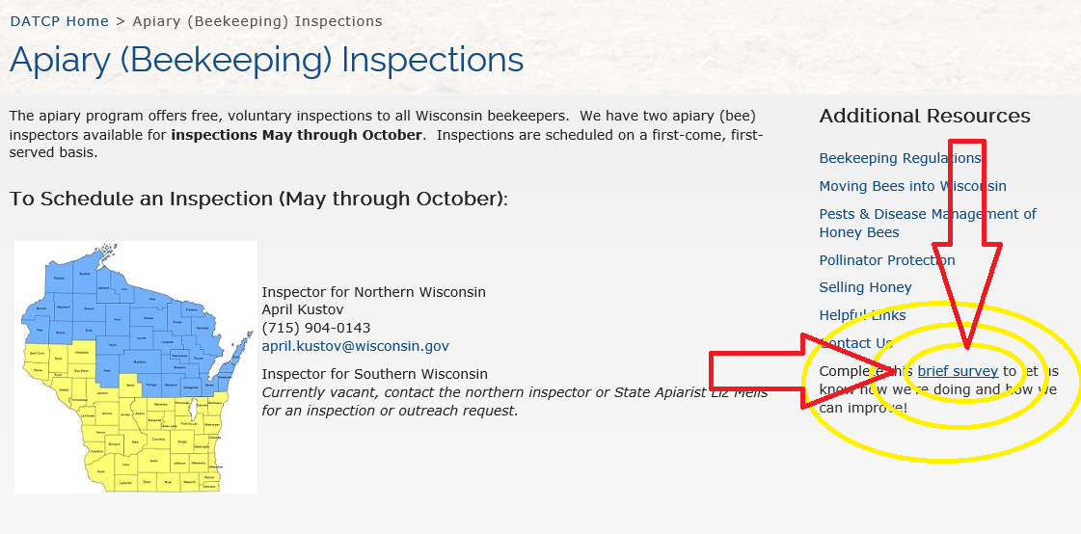
Survey
Please complete our brief survey

Slide 3
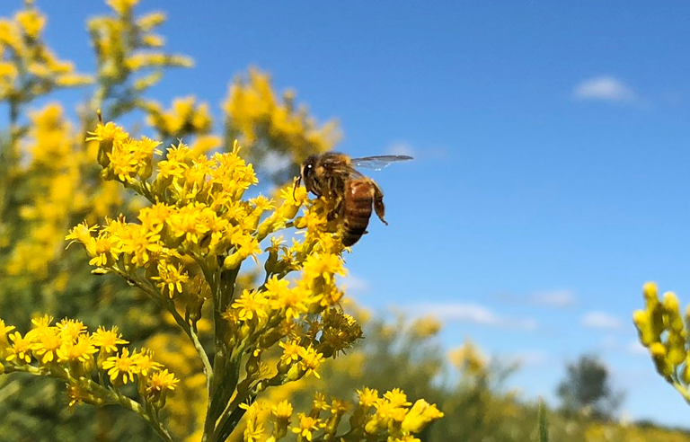
Seasons
Spring: Pre honey flow
Temps are variable
Few flowers are blooming
Feeding?
Summer: Honey flow
Flowers are blooming!
Bees are flying regularly
Early Fall: Honey has been removed (mid-August)
Days are still warm
Feeding?
Late Fall:
Cooler days - temps are variable
No longer feeding
Winter:
Cold
Random 50℉ day? Can you treat for VM?
Photo by: April Kustov

Slide 4
The Label is the Law
This presentation, and the Wisconsin Honey Bee Pest Management Options handout can be used as a guide, but always follow the instructions/label associated with the product you are using.
The label is the law!
For more helpful tips and information visit our website:
datcp.wi.gov https://datcp.wi.gov/Pages/Programs_Services/ApiaryProgram.aspx

Slide 5
Synthetic Chemicals

Slide 6
Do NOT Use!!!
Apistan (Fluvalinate)
CheckMite+ (Coumaphos)
Taktic: Has the potential to poison humans and also to cause cancer in humans. ***Illegal to use in honey bee colonies in the USA.***
Varroa
Tropilaelaps

Slide 7
Apivar Strips (Amitraz)
Amitraz is an acaricide (which are pesticides that kill members of the arachnid subclass Acari, which includes ticks and mites).
It paralyzes the varroa mite, which then drops off the bee, and starves to death.
Amitraz is on the surface of the strips, bees come in contact with the amitraz and then spread it throughout the colony from bee to bee. After a short period of time, amitraz is hydrolyzed (undergo chemical breakdown due to reaction with water) and disappears from the hive.

Slide 8
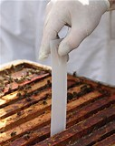
Apivar Strips
Use in early Spring before nectar flow, or Fall after honey supers have been removed.
Can be used with brood
Treatment time is 42 days = effective for multiple VM reproductive cycles
Can be used 2 times per year
Strips hang down between frames in brood chamber

Slide 9
Amitraz
*****The agricultural formulations of Amitraz are dangerous poisons! Pease do NOT illegally apply! You are putting yourself at risk!****
Is the varroa mite developing a resistance?
Randy Oliver (American Bee Journal)
-Beyond Taktic (January 2017)
-Amitraz: Red Flags or Red Herrings? (October 2014)

Slide 10
Organic Acids

Slide 11
HopGuard II & HopGuard III
A miticide (an agent used to kill mites) created from hops
Potassium salt of hop beta acids
Hops contain two prominent organic acids, alpha acids (known to brewers as “flavor” hops) and beta acids (known as “aroma” hops). It is the beta acids that have been found to have anti-varroa properties.

Slide 12

HopGuard II
Best with little to NO brood (Does NOT penetrate the brood cap.)
Spring
Swarm
New package
30-day treatment
Can be used with honey supers on
BUT recommended to not harvest honey or wax from brood chamber: “Even though the product is safe to use during nectar flow, DO NOT apply it in the honey supers. And please don’t be tempted to use honey or wax that is in the brood chamber!” (Hopguard® II revisited By Dr. Elina L. Nino, Extension Apiculturist. UC, Davis)
Can use for 3 applications per year MAX
Strips hang over and down, between brood frames
The daytime temperature should be above 50°F

Slide 13
Formic Pro & Mite Away Quick Strips (MAQS)
Formic Acid: An organic acid that naturally occurs in honey and bee venom
Acts as an asphyxiant
Works to also kill Tracheal mites
“With the use of 65% acid and a continuous low dose release method, we have experienced no young queen losses due to Formic Acid applications since 1995.” (MiteGone Enterprises Int.)

Slide 14
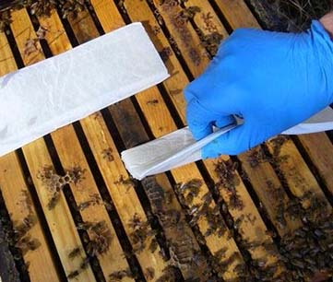
Formic Pro
Causes mortality to both male and female varroa under the brood cap as well as to the varroa on the adult bee
14-day treatment or two 10-day treatments
Can be used during honey flow (great summer treatment)
DO NOT FEED DURING TREATMENT: Bees will continue to forage, do not disturb the hive (Vapor)
A presoaked pad that lays over the top of the hive frames in the brood chamber
Daytime temps of 50-85℉

Slide 15
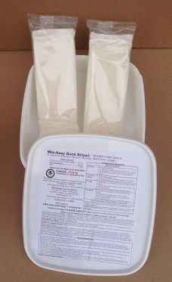
Mite Away Quick Strip
“Allow a minimum of 1 month between applications for the 7-day treatment.” (http://nodglobal.com/faq-maqs/)
Kills mites on adult bees and mites under the brood cap: Great summer treatment
Outside daytime temperature between 50-85℉
**92℉ + during the first three days of treatment may
cause excessive brood mortality and queen loss.**
7 or 21 day treatment
An organic vapor-action formulated in a pre-soaked pad that lays on top of the hive frames in the brood chamber.

Slide 16
Differences?
***MAQS***
-12-month shelf life
-7 or 21 day treatment
-Storage: Under 77℉
***Formic Pro***
-24-month shelf life
-14 or 20 day treatment
-Storage: Out of direct sunlight
“Next Generation of MAQS”

Slide 17
Oxialic Acid
Occurs naturally in many foods including honey.
(It’s what makes rhubarb leaves poisonous.)
The acid works by direct contact with the varroa mite attached to adult bees.
*Side note: PLEASE do not use rhubarb leaves in your hive to treat the varroa mite

Slide 18
Oxalic Acid
Little to NO brood: Does NOT penetrate capped brood
Do NOT treat during honey flow, or with honey suppers on.
Late fall or early spring
Broodless packages or swarm
Dribble: Method of dribbling the solution evenly between frames directly on the cluster of bees.
Vaporize: Use a machine to vaporize the acid into the hive body. A very good treatment option for cool temperatures and poor weather conditions.

Slide 19
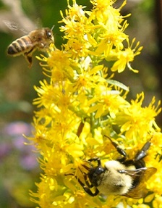
Essential Oils

Slide 20
ApiGuard
Thymol: Naturaly occurring, it provides the distinctive flavor in the herb thyme, and also in the native wildflower bee balm.
***Acts as a vapor***
***Will only kill mites on adult bees***
(Does not penetrate the brood cap)
(Gel form will give a controlled release: In crystal or powder form, if the weather is cold the thymol crystals do not sublime quickly enough and mites are not controlled; but in hot conditions thymol crystals will sublime to quickly, shocking the bees into absconding and often killing bee brood.)
*Article in Bee Culture Magazine: https://www.beeculture.com/thymol-varroa-control/
(From the February 27, 2018 issue)

Slide 21
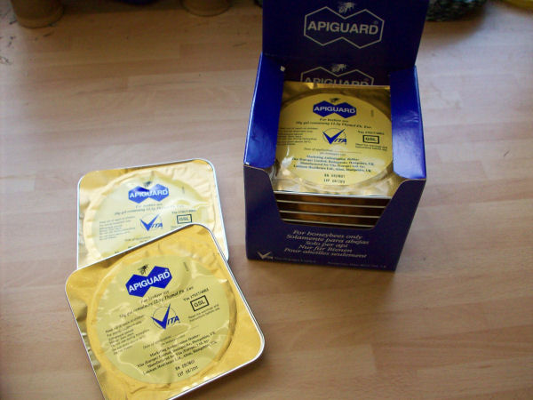
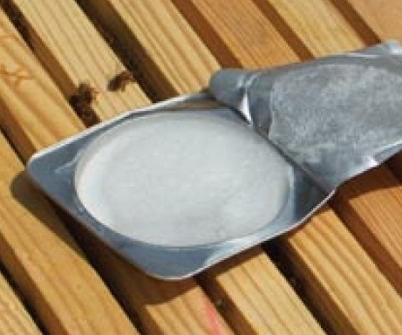
ApiGuard
25% Thymol
Early Fall treatment: After honey supers are removed, and day temperatures are still above 60°F (bees need to be active).
Thymol will sometimes cause the queen to stop laying for a short period, so it’s best NOT to use in the spring.
Try not to apply feed simultaneously because the bees might feed and no clean out the gel
A slow release gel in a tray: Place tray on top of honey frames. Bees will pick up the gel to throw it out of the colony. It will sublime as it’s moved and spread throughout the colony, killing varroa mites. Bees need to be active for this treatment to work.
Close screen bottom board during treatment
Effective for mites on adult bees: Does NOT penetrate brood cap

Slide 22
Api Life Var
Thymol: 74%
Eucalyptol
Menthol

Slide 23
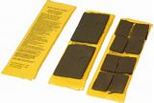
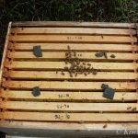
Api Life Var
Early Fall: After honey supers are removed
Close screen bottom board
Temperatures should be between 64-95°F
Comes in a soaked tablet: Break tablet into 4 pieces and place a piece on each of the 4 corners of brood nest.
Three applications are necessary at 7-10 day intervals
Effective for mites on adult bees: Does not penetrate brood cap

Slide 24
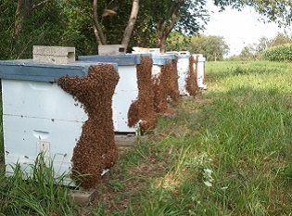
Integrated Pest Management

Slide 25
IPM
Change treatments throughout the season
Hygienic bees: Introducing a hygienic queen
Screen bottom boards
Remove drone comb
Split hives
Varroa mite check!!!
Location
Food availability
Reduce hive stress
The Integrated Pest Management (IPM) pyramid (Figure from E. Niño, 2015)

Slide 26
Varroa Mite Check: It is Important to monitor mite levels and act before mite populations are high
Powder sugar roll
Alcohol wash
½ cup of bees = 300 bees
3 mites = Treatment (“action”)
“Typically, a 3 percent mite load, (where 3 out of 100 adult honey bees are carrying one or more mites), is the level at which to consider controlling with miticides or taking drastic non-chemical IPM approaches to quickly knock down mite populations. In March, a beekeeper should consider controlling the mites at even the one or two percent infestation level, as infestations typically grow in the spring, stay static or decrease in the summer, and drastically increase again in the fall. A two percent mite load in March, if left untreated, can have devastating effects by the end of summer or early fall. A two percent load in September may indicate that the mite level is under control.” (Liz Walsh, Texas A&M University and Kent Pegorsch, WHPA President)

Slide 27
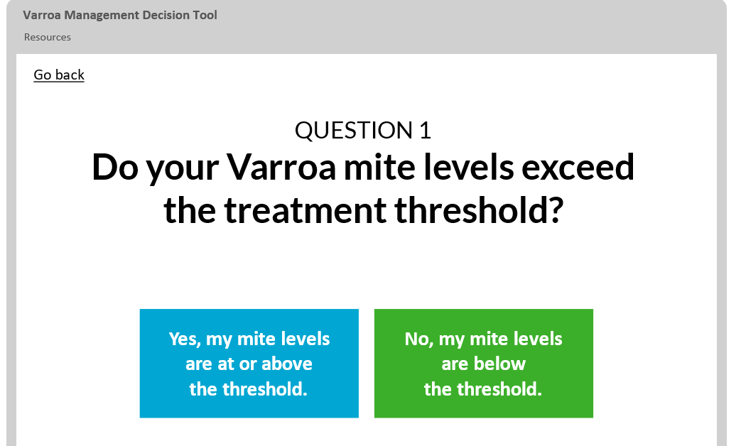
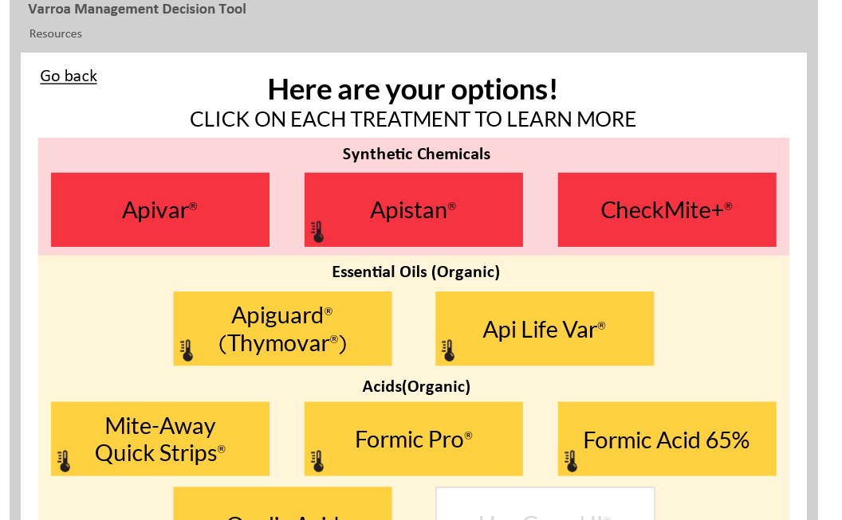
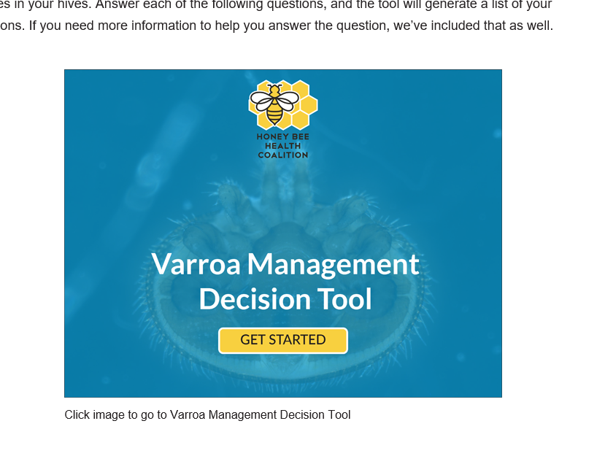
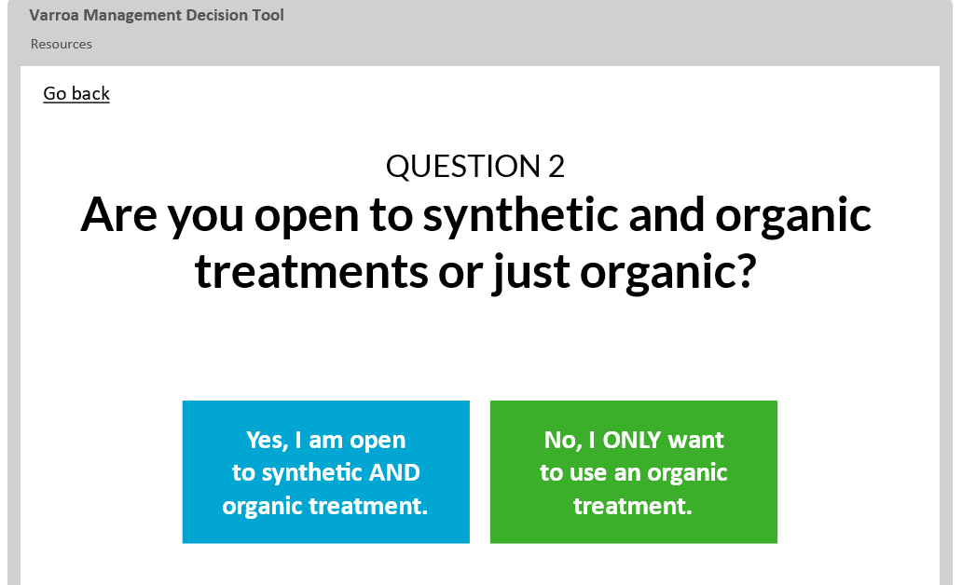
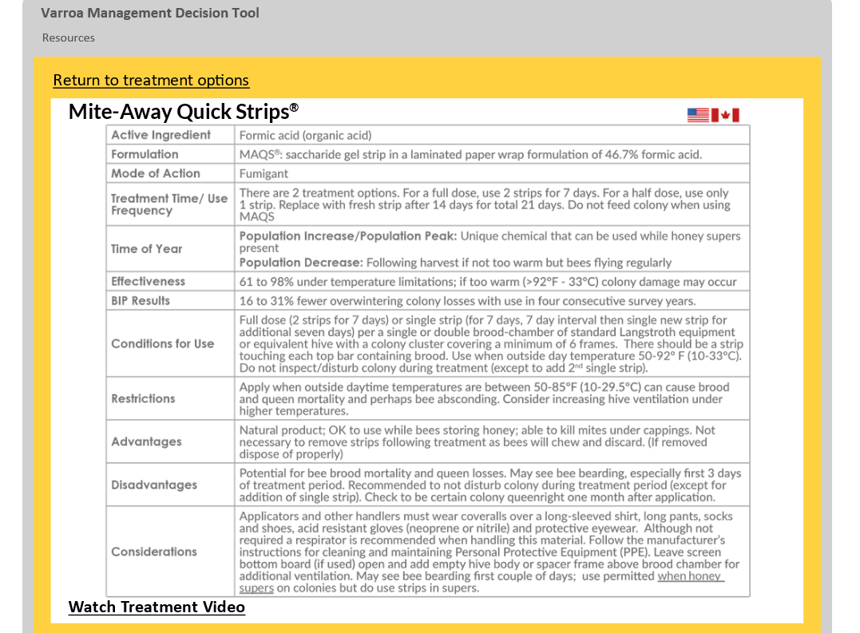
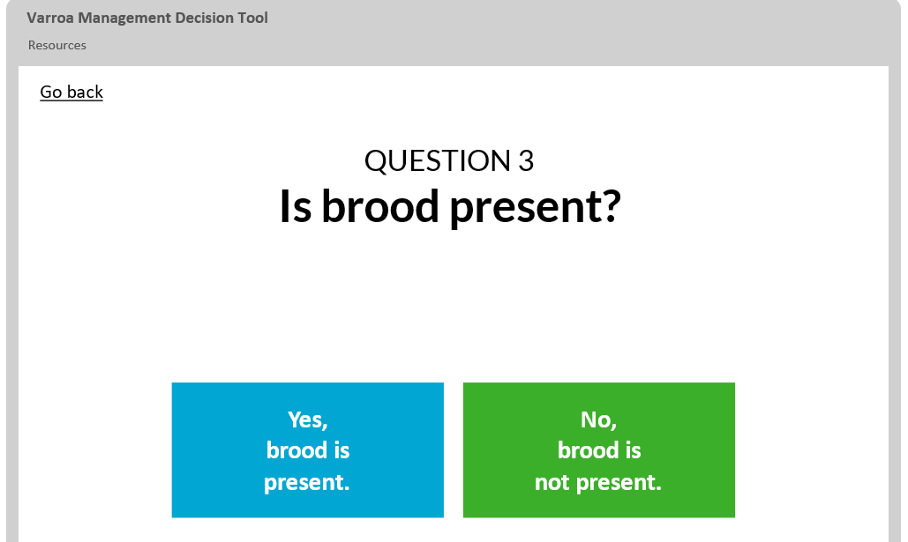
Varroa Management Decision Tool
https://honeybeehealthcoalition.org/varroatool/

Slide 28
Resources
Wisconsin Department of Agriculture, Trade and Consumer Protection
www.datcp.wi.gov (Search for honey bee)
https://datcp.wi.gov/Documents/TreatmentOptions.pdf (WI Pest Man. Guide)
The Wisconsin Pollinator Protection Plan
http://datcp.wi.gov/Documents/PPPBeekeepers.pdf
Honeybee Health Coalition
www.honeybeehealthcoaliton.org

Slide 29
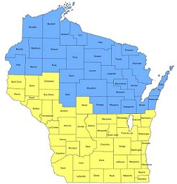
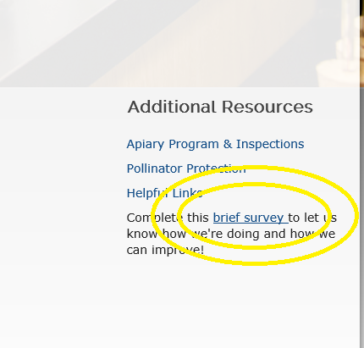
April Kustov
april.kustov@wisconsin.gov
(715) 904-0143

